Slide 1
NGINX –the nextgen
-Joel Vivek Iniyan Raja

Slide 2
Industry Experience

Slide 3
Agenda

Slide 4
NGINX intro
NGINX came around 2004 by Russian Igor sysoev
Due to frustration of Apache, Today more than 10000 websites
Large number of third party module to extend

Slide 5
Lab Pre-Requisites
Internet
Any Cloud Account
Linux Machine

Slide 6
NGINX can be used as follow
NGINX as Webserver
NGINX as Reverse Proxy
NGINX as Load balancer

Slide 7
NGINX is Asynchronous
Webserver : Webserver is a computer that deliver a request of a web page each webserver has IP address and domain name
Other Webservers: Apache, XAMPP, tornado, MS ISS

Slide 8
NGINX Installation
We will use Linux based server, OS either Ubuntu / CentOS
We can use AWS / Digital Ocean
To create an AWS account see this link
To create a Digital Ocean Account, link
Running a host machine
To create AWS EC2 link
To create Digital Ocean Droplet link

Slide 9
NGINX Installation
We can install NGINX in the following
via Source (using wget from the NGINX page)
via yum for Centos (This will install and need to start the service manually)
via apt-get for ubuntu (this will install and deploy automatically)
We will install via yum install nginx
Yum update (the new server needs the required packages)
Yum install nginx (that’s it, it is done install)
Nginx –V (to verify the nginx is there on the server or not, it also shows the version that we installed)

Slide 10
NGINX installation yum install
Yum update
Yum install nginx
Nginx –V

Slide 11
NGINX installation via source
Advantage, we can use the third-party or custom module
https://nginx.org/en/download.html
http://nginx.org/en/docs/configure.html
Commands
yum group install Development Tools
yum install pcre pcre-devel zlib zlib-devel openssl openssl-devel
./configure --sbin-path=/usr/bin/nginx --conf-path=/etc/nginx/nginx/conf --error-log-path=/var/log/nginx/error.log --http-log-path=/var/log/access.log --with-pcre --pid-path=/var/run/nginx.pid
Make
Make install
nginx

Slide 12
Running the nginx service
To Start, stop, status the service
Service nginx start (Start the nginx)
Service nginx stop (stop the nginx)
Service nginx status (status of the nginx)
Service nginx restart (to restart the nginx)
systemctl start nginx (start the nginx with additional info)
systemctl stop nginx (start the nginx with additional info)
systemctl status nginx (start the nginx with additional info)
systemctl restart nginx (start the nginx with additional info)
./nginx (start the nginx)
nginx -s (stop the nginx)
Nginx –h (for any help)

Slide 13
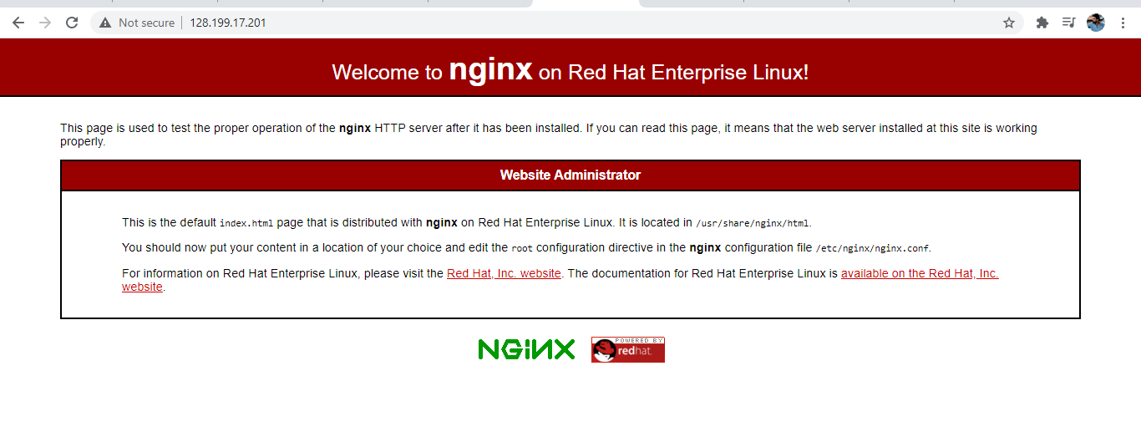
Check the browser with the ip

Slide 14
Nginx.org and Nginx.com
Nginx.org for the documentation, downloads and for reference, modules etc.
If we want to install a different version, we can download the file from here and install it http://nginx.org/en/download.html
Nginx.com is the product page or landing page, also used for paid version of product like nginx plus

Slide 15
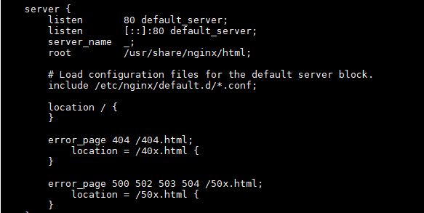
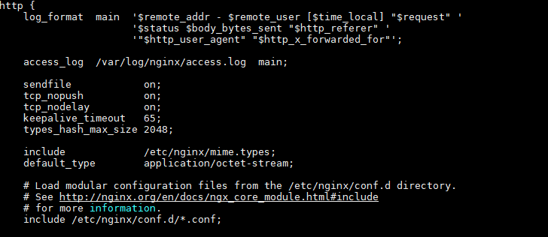
Configuration terms
Context can be set for give context also called scope
Directive having name and value
Main Context is the config file itself
HTTP context for anything HTTP related
Server context which is where we define a virtual host similar to an Apache V host
Location contexts for matching URI locations on incoming requests to the parent server context again when using the engineer's

Slide 16
Location Block
The location directive within NGINX server block allows to route request to correct location within the file system.
The directive is used to tell NGINX where to look for a resource by including files and folders while matching a location block against an URL
Exact Matches = uri
Preferential Prefix Match ^~ uri
REGEX Matches ~* uri
Prefix matches uri

Slide 17
Variables
Reference
https://nginx.org/en/docs/varindex.html
Configuration Variables
Set $var ‘value’;
NGINX module variable
$http, $uri, $args

Slide 18
Rewrite / Redirect
Rewrite Pattern URI
Return Status URI
Re-direct tells you the page has been re-direct to some other url. There will be a url change.
Re-write internally changes the page, but it will still show the same url

Slide 19
Try Files
Try file can come in the Server block or location context
Tries the files available in the path given.
try_files $uri /file1 /file2;
Reference
http://nginx.org/en/docs/http/ngx_http_core_module.html#try_files

Slide 20
Master & Worker Process
Try file can come in the Server block or location context
Tries the files available in the path given.
try_files $uri /file1 /file2;
Reference
http://nginx.org/en/docs/http/ngx_http_core_module.html#try_files

Slide 21
Logs and Directives
3 Types of directives
Standard : Can only be declared once.
Array : Can be specified multiple times without overriding a previous setting
Action : Invokes an action such as a rewrite or redirect
Logs
Error Log
Access Log

Slide 22
HTTP2, HTTPS/SSL, TLS HSTS
HTTP /HTTP2
As opposed to HTTP/1.1, which keeps all requests and responses in plain text format, HTTP/2 uses the binary framing layer to encapsulate all messages in binary format
SSL/TLS
Transport Layer Security (TLS) is the successor protocol to SSL. TLS is an improved version of SSL. It works in much the same way as the SSL, using encryption to protect the transfer of data and information
HSTS
HTTP Strict Transport Security (HSTS) is a web security policy mechanism that helps to protect websites against man-in-the-middle attacks such as protocol

Slide 23
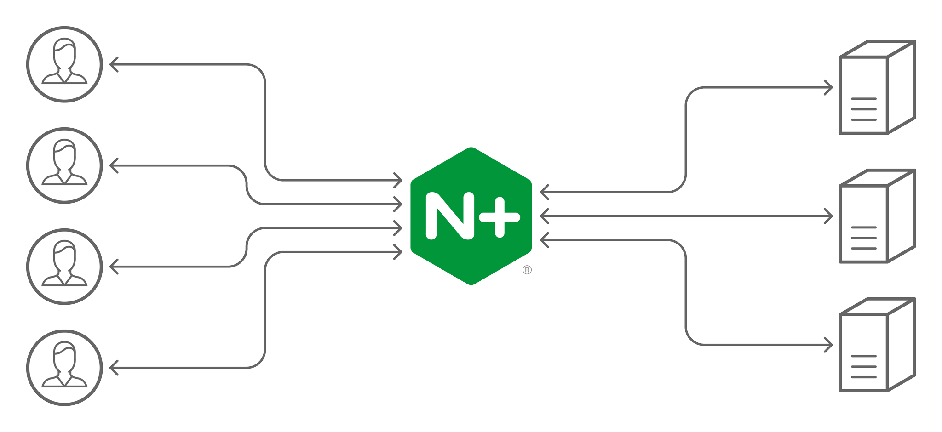
NGINX as Load Balancer
Load balancing is the process of distributing a workload evenly across multiple servers.
The second is redundancy –
if one server fails, others are available to ensure the application stays online.

